Slide 1

EMERGING OPPORTUNITIES: Opening scholarship
William Cross
Austin, Texas
June 21, 2013
ACRL Scholarly Communications Roadshow:
From Understanding to Engagement

Slide 2
What do we mean by open?
Open to contributions and participation
Open and free to access for all
Open to use & reuse with few or no restrictions
Open to interoperability & machine readable

Slide 3
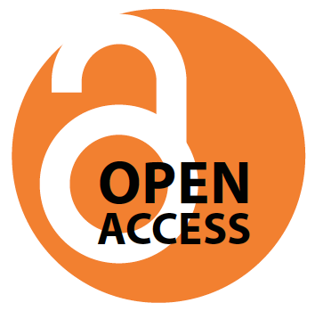
Open Access
Open access literature is digital, online, free of charge, and free of most copyright and licensing restrictions.
- Peter Suber

Slide 4
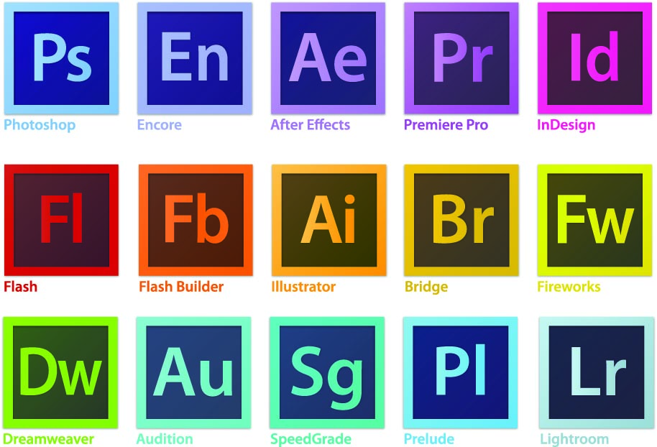
FROM…
are either registered trademarks or trademarks of Adobe
Systems Incorporated in the United States and/or other countries.

Slide 5
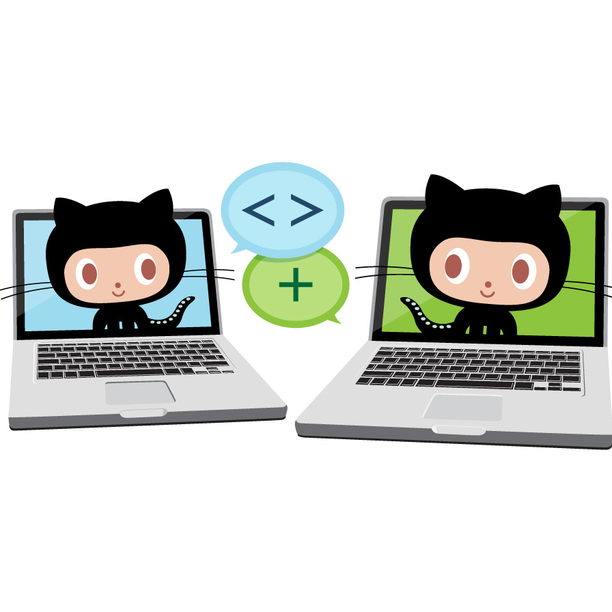
PARTICIPATE
in
BUILDING
and
CONTRIBUTE
EXPERTISE
Octocat® is a registered trademark of the GitHub, Inc.

Slide 6
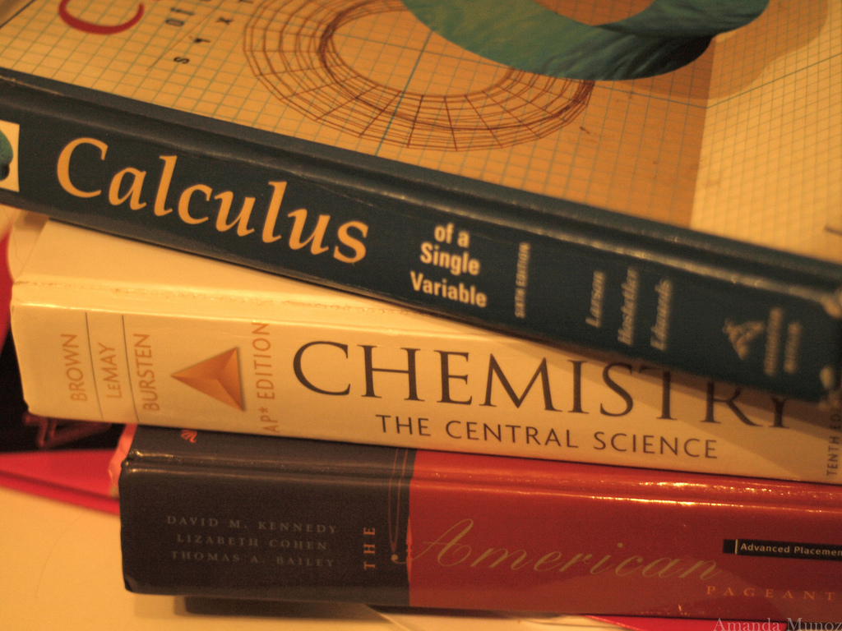
FROM…
©Amanda Munoz, used with permission under CC-BY

Slide 7
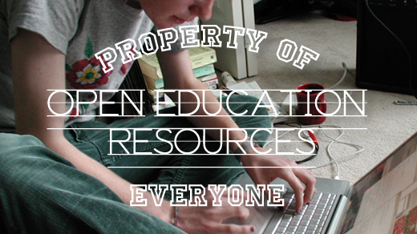
OPEN and FREE TO ACCESS
©OpenSourceWay, used with permission under CC BY-SA

Slide 8
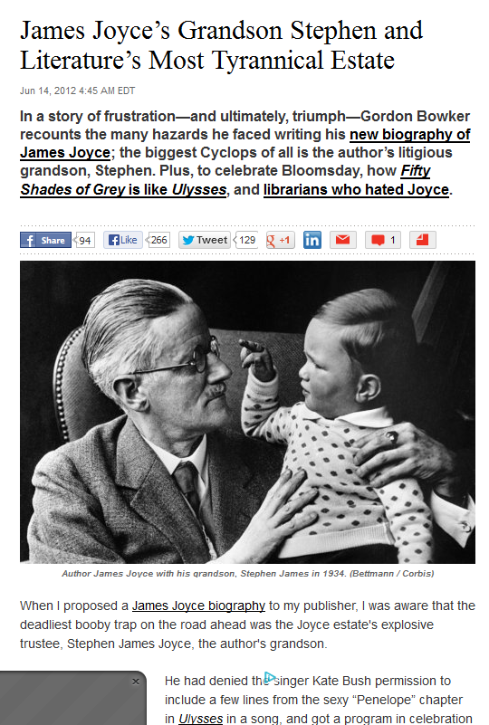

FROM…

Slide 9
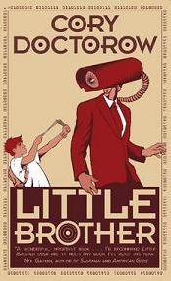
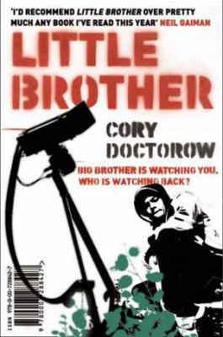
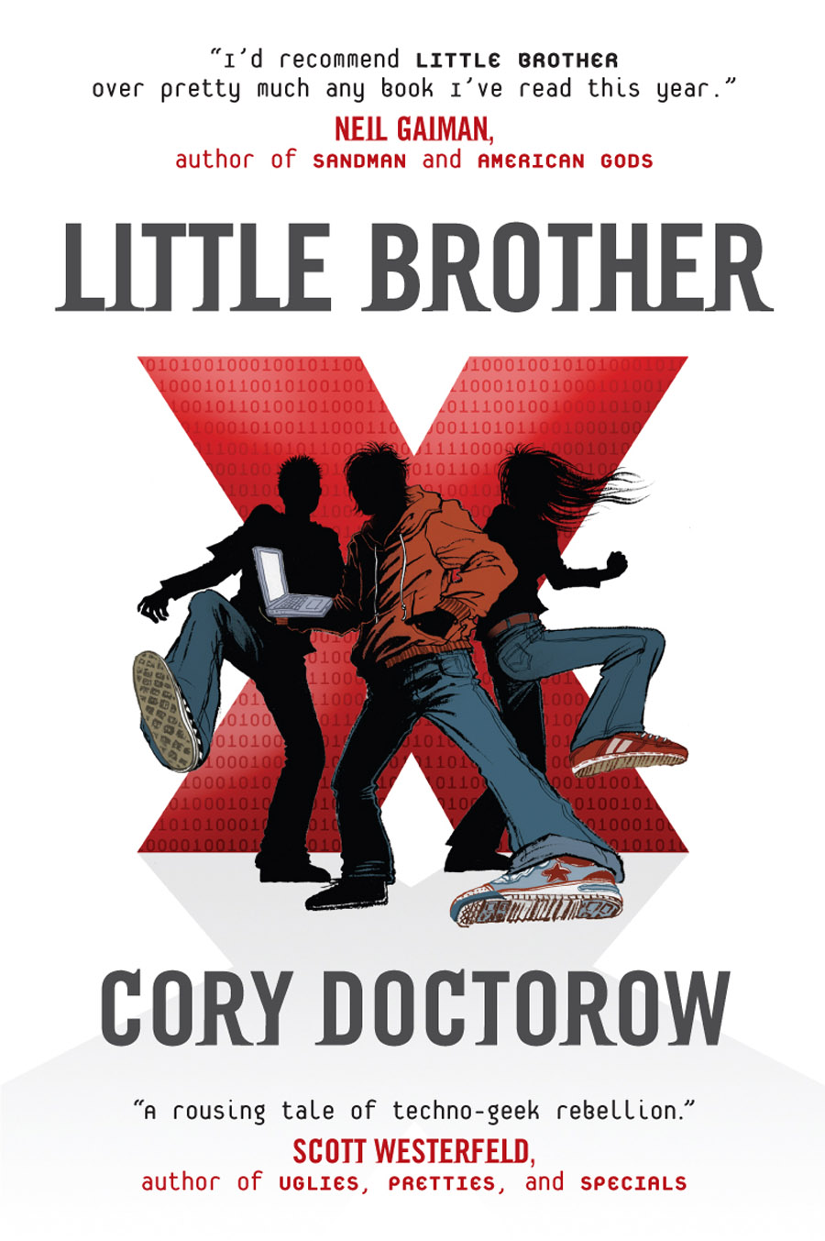
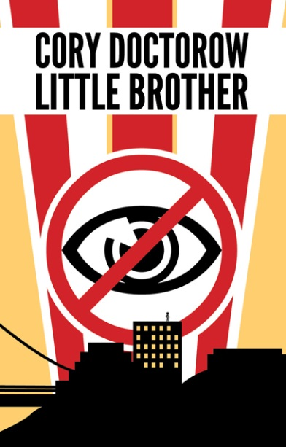
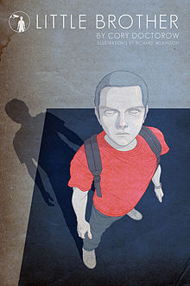
OPEN TO USE and REUSE WITH FEW or NO RESTRICTIONS

Slide 10
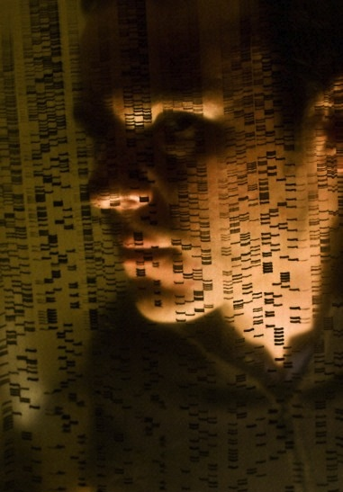
FROM…
©Wellcome Images, used with permission under CC BY-NC-ND

Slide 11
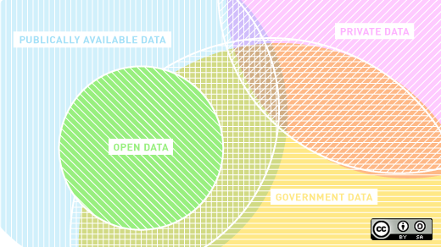
OPEN TO USE and REUSE WITH FEW or NO RESTRICTIONS
©OpenSourceWay, used with permission under CC BY-SA

Slide 12
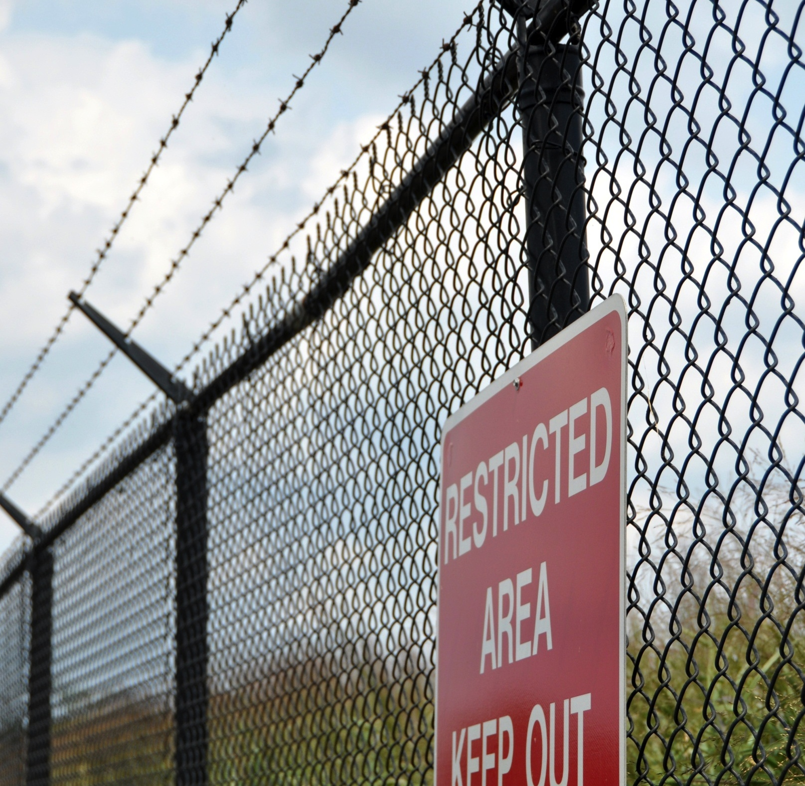
FROM…
©Kevin Harber, used with permission under CC BY-NC-ND

Slide 13
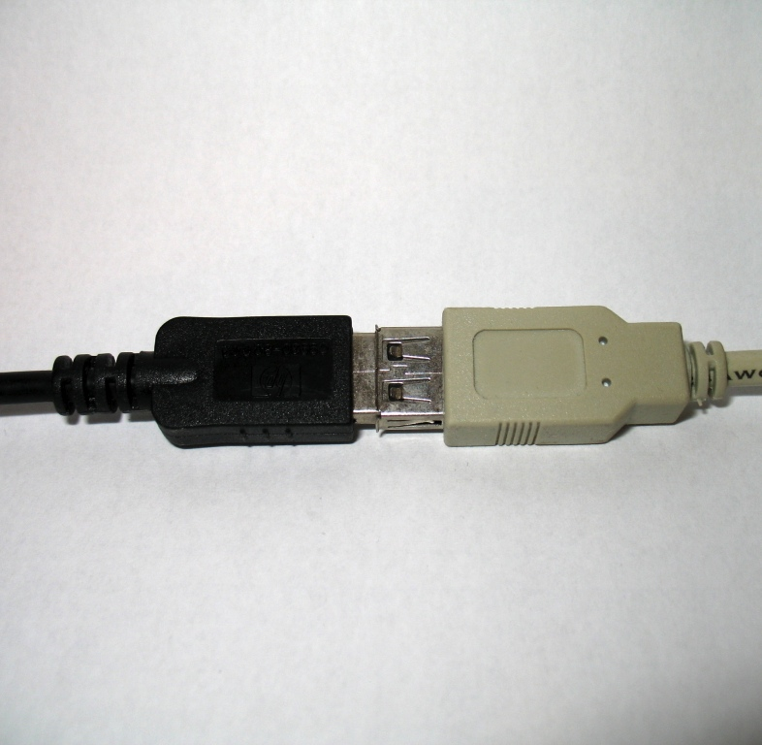
Interoperable
and
Machine Readable
©24oranges.nl, used with permission under CC BY-SA

Slide 14
Commonalities
Generally enabled by technology
Works both inside and outside of traditional models
Supported by a variety of business models
Democratization of information

Slide 15
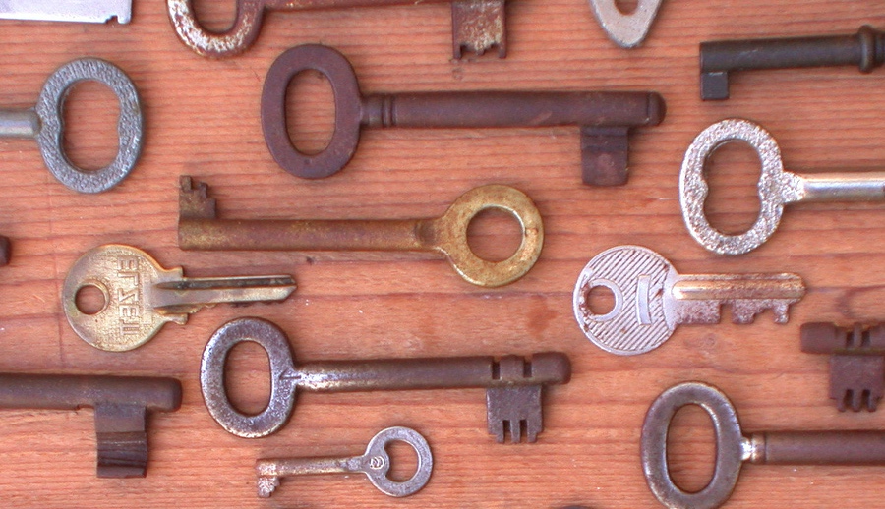
Opening the Academy…
©Taki Steve, used with permission under CC BY

Slide 16
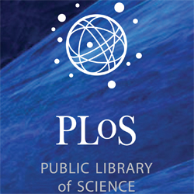
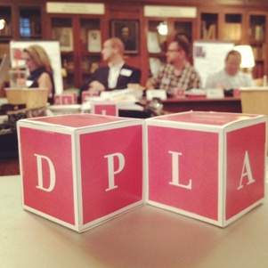
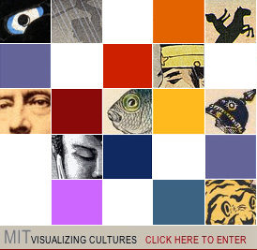
Success Stories
Sciences
Social Science
Humanities

Slide 17
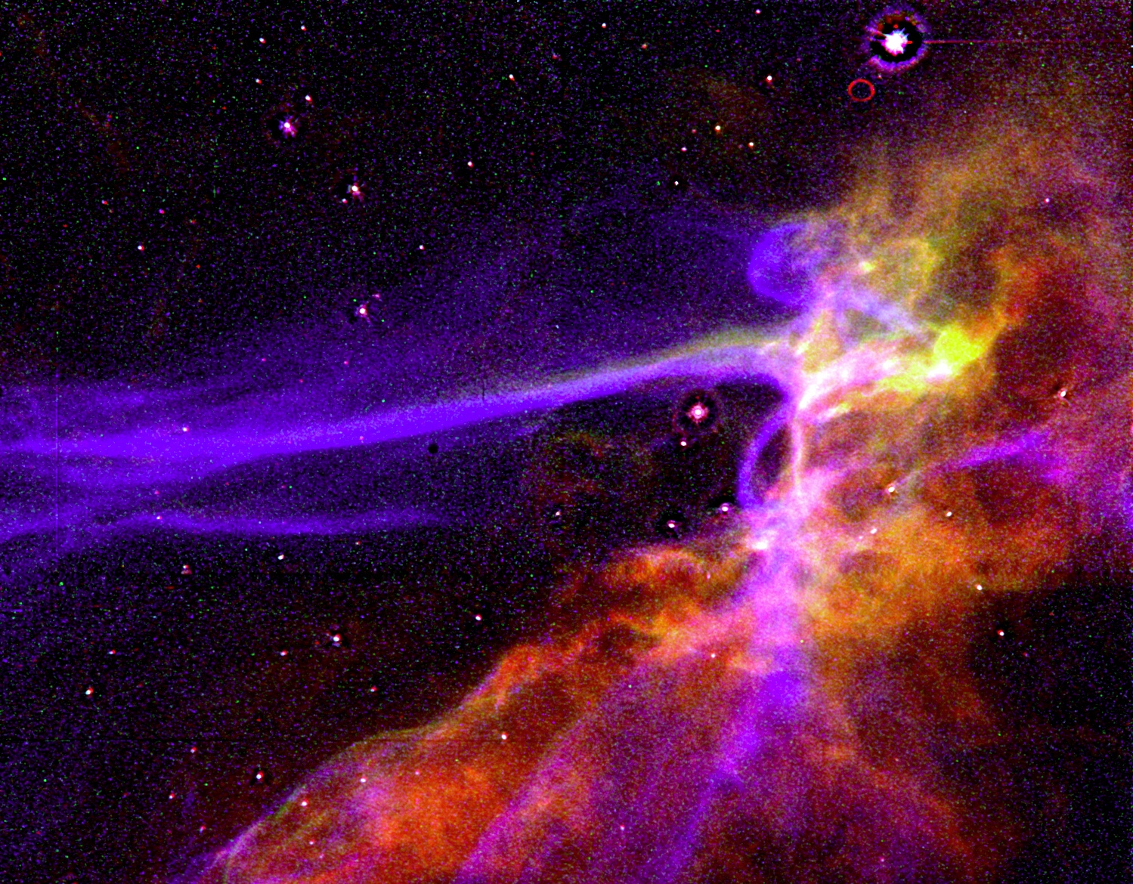
OPENNESS IN THE ScienceS
Source: NASA

Slide 18
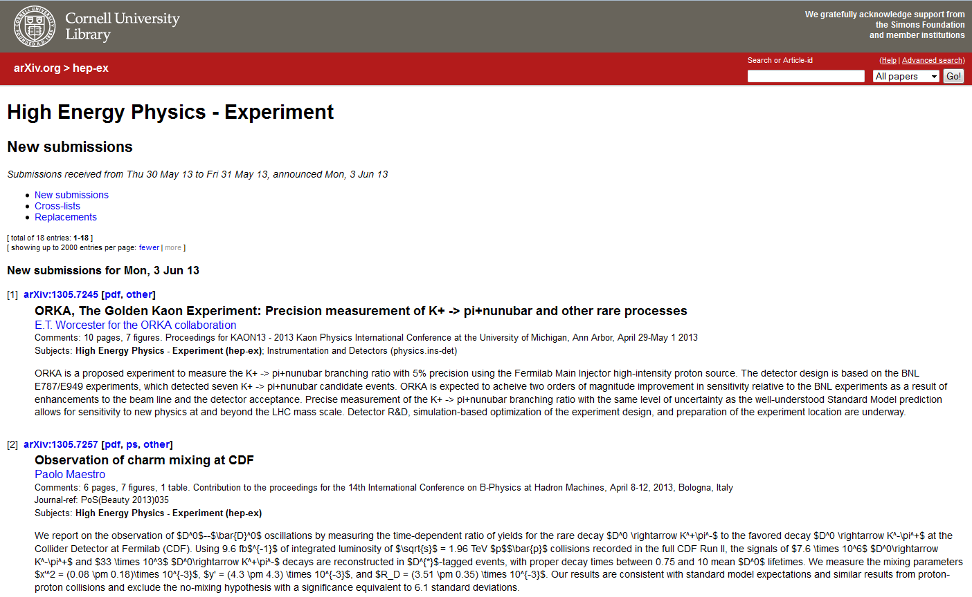

Slide 19
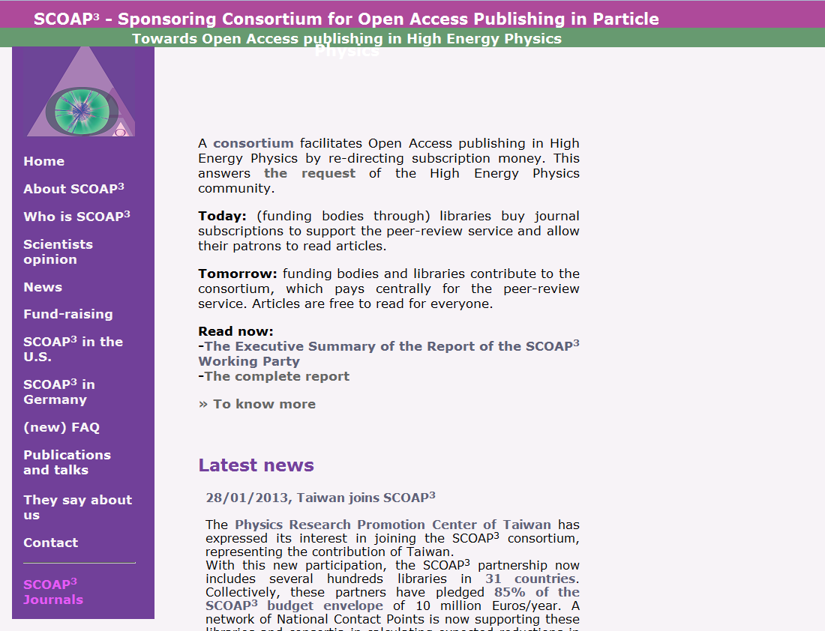

Slide 20
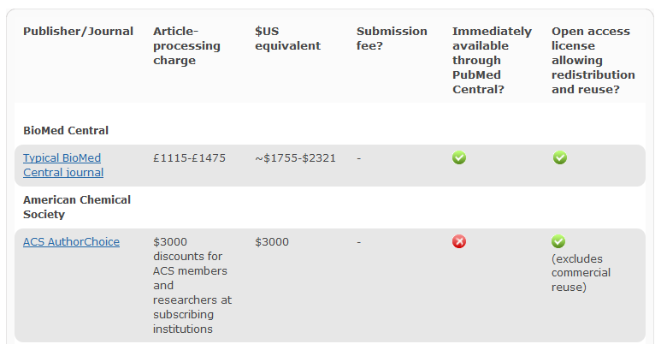
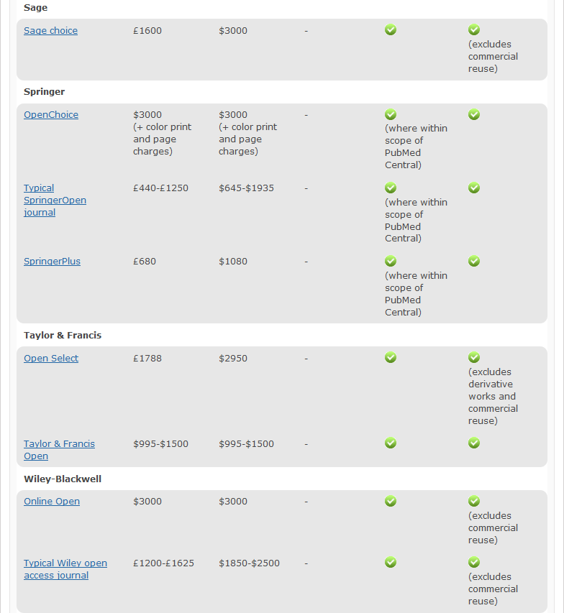

Slide 21
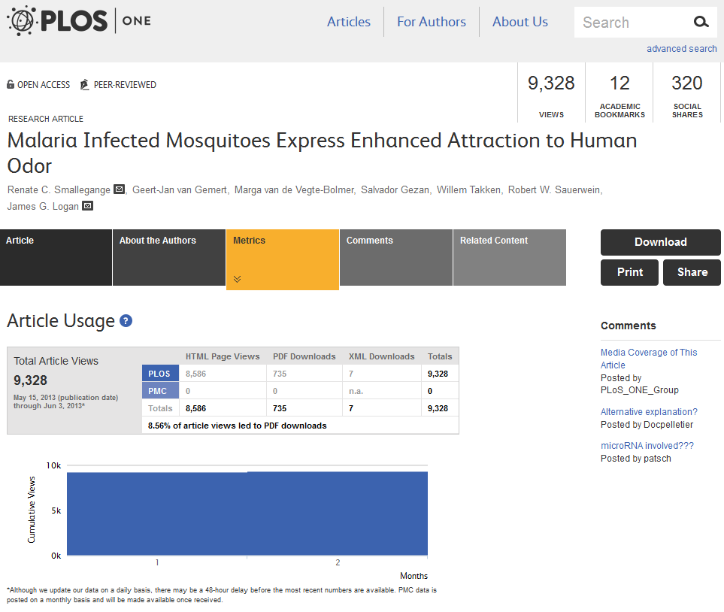

Slide 22
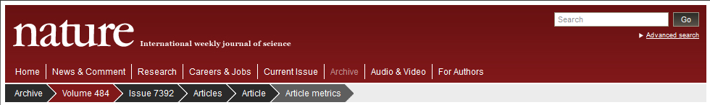
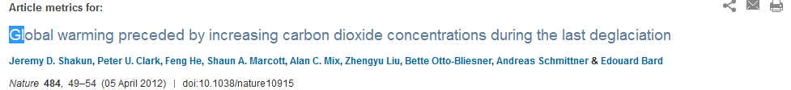
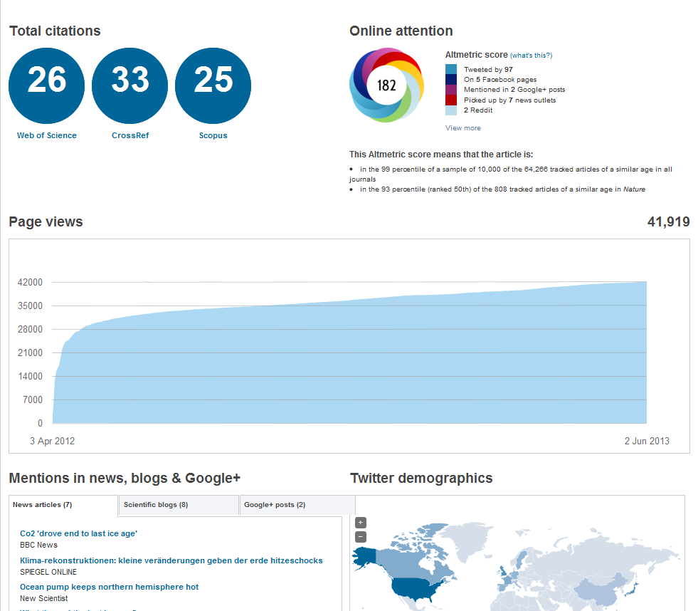

Slide 23
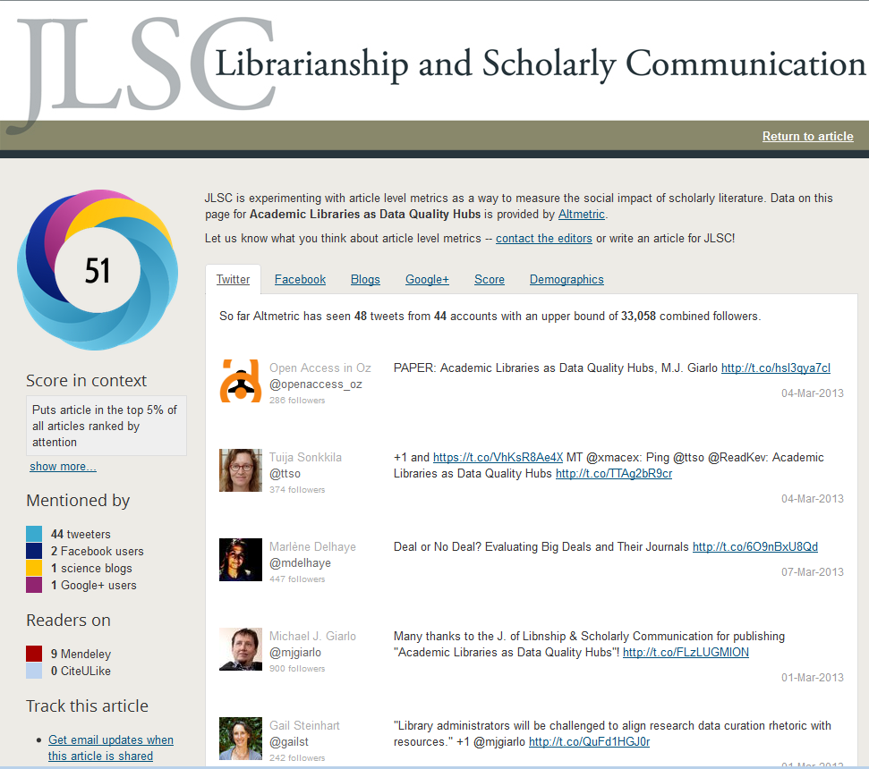

Slide 24
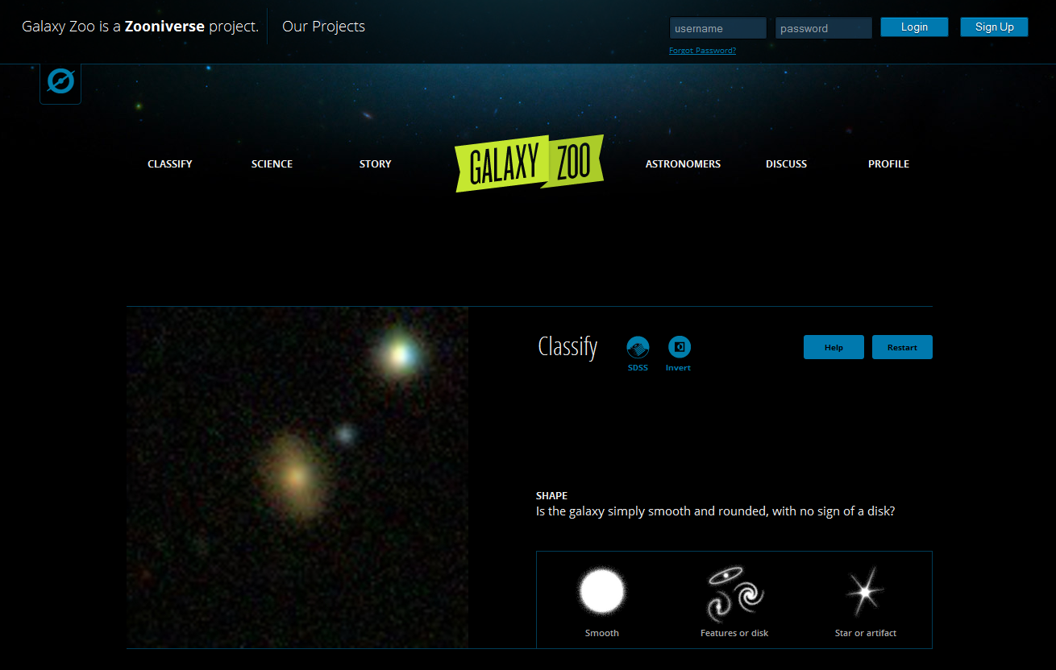

Slide 25
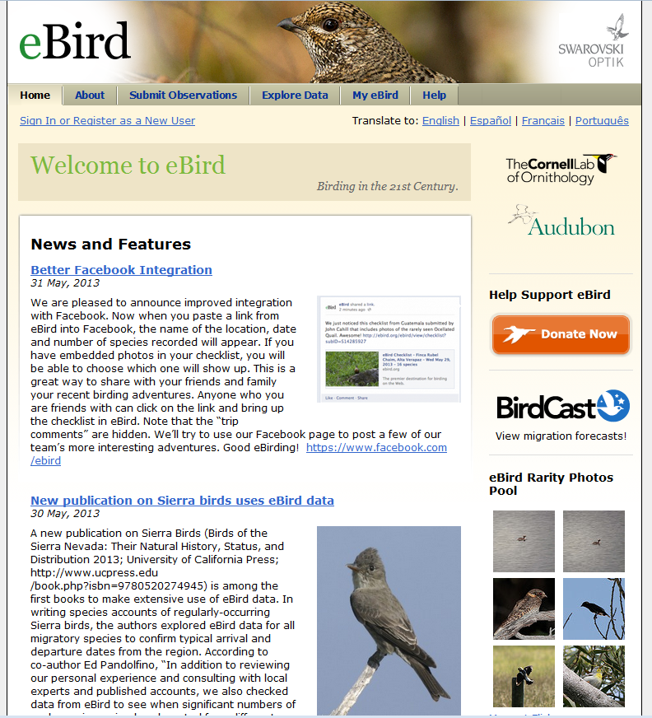

Slide 26
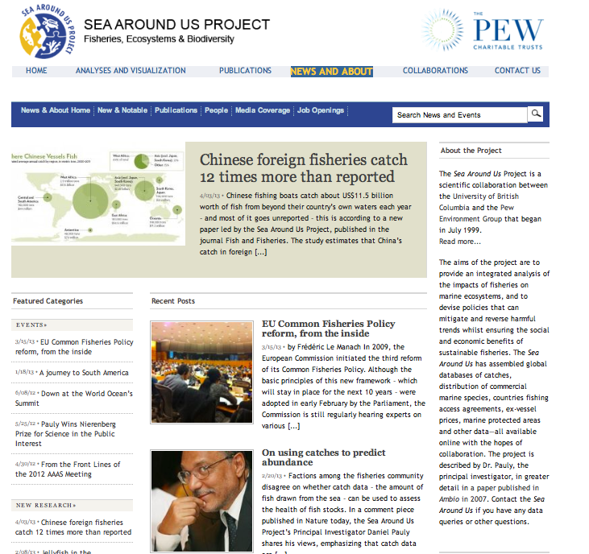

Slide 27
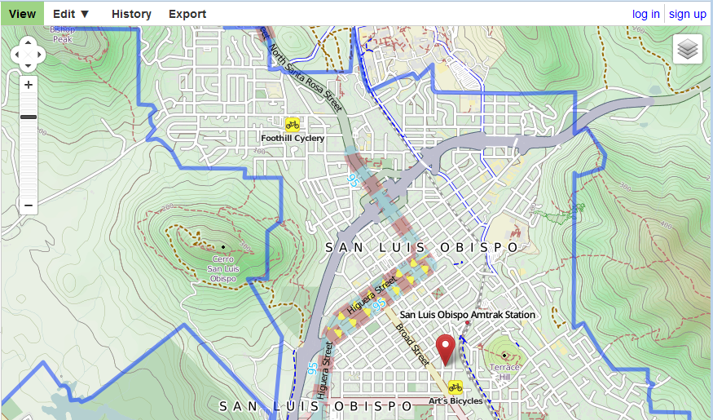
OPENNESS IN THE Social Sciences

Slide 28
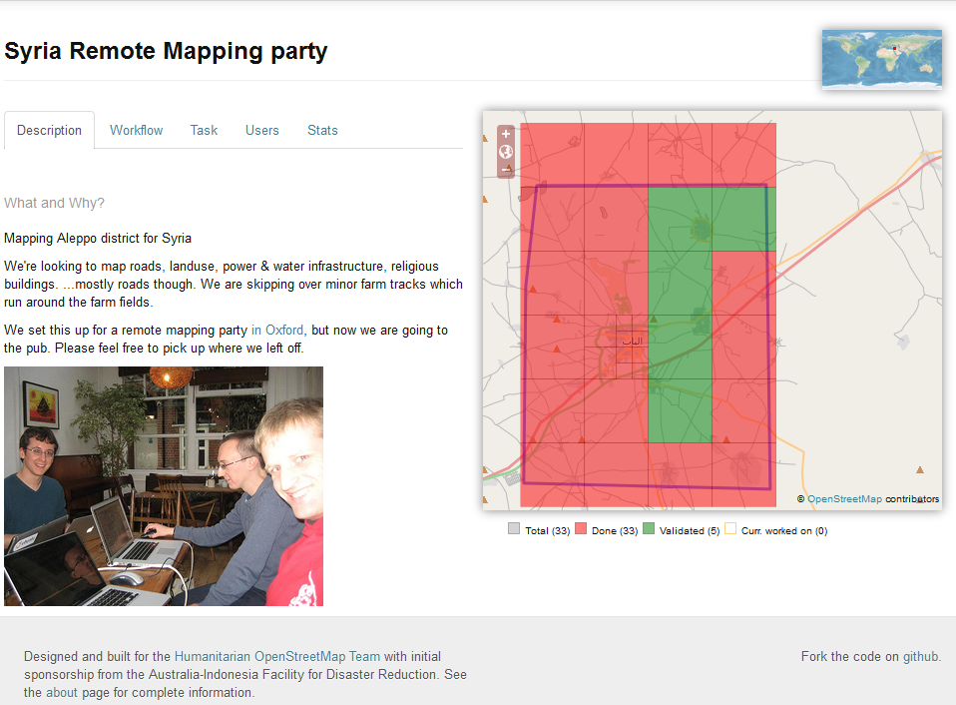
Source: Screengrab from OSM Tasking Manager (http://tasks.hotosm.org/job/196)

Slide 29
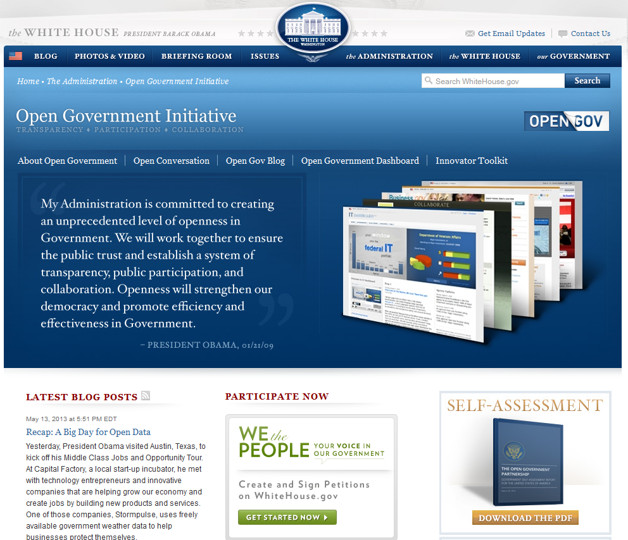

Slide 30
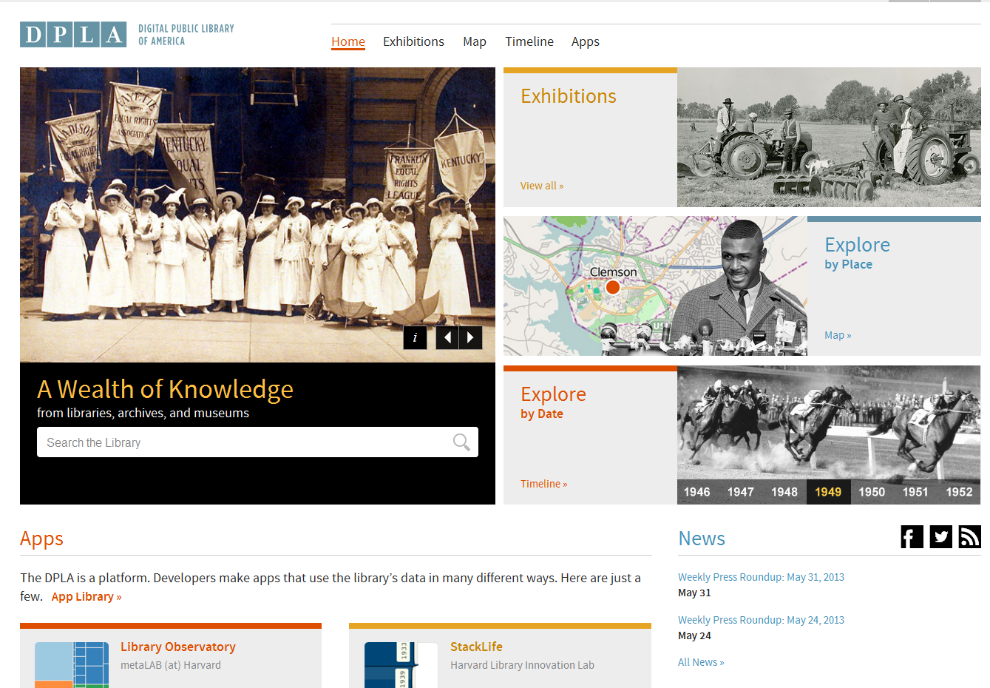

Slide 31
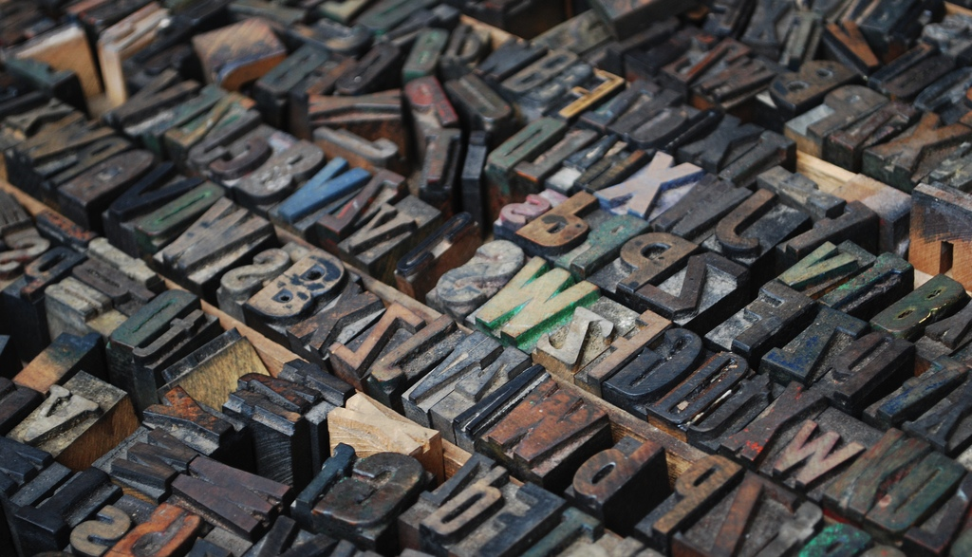
OPENNESS IN THE Humanities
© Bettinche, used with permission under CC BY-NC

Slide 32
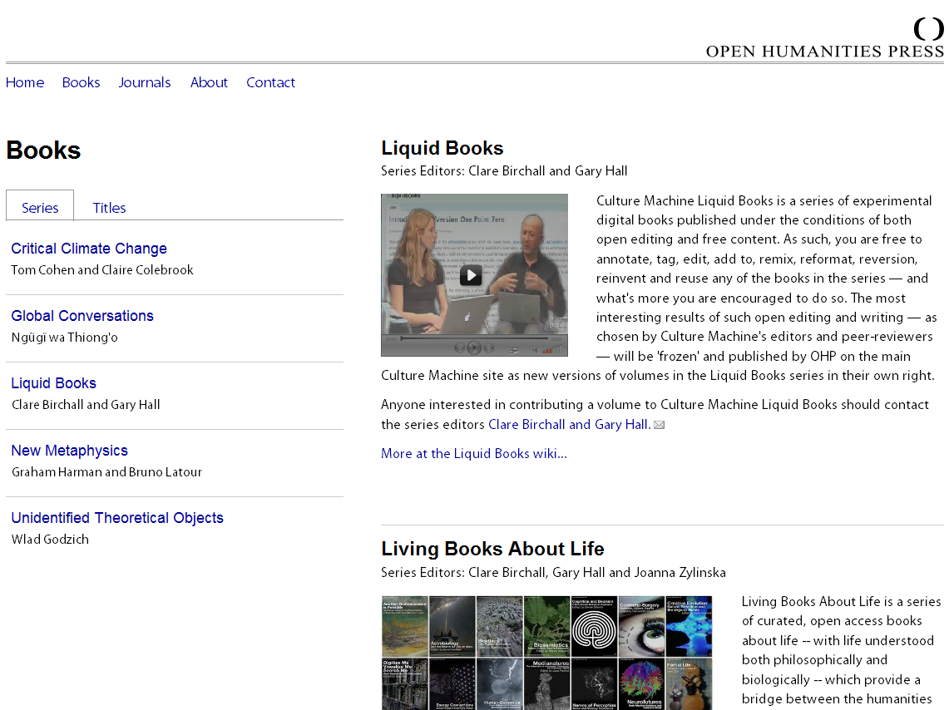

Slide 33
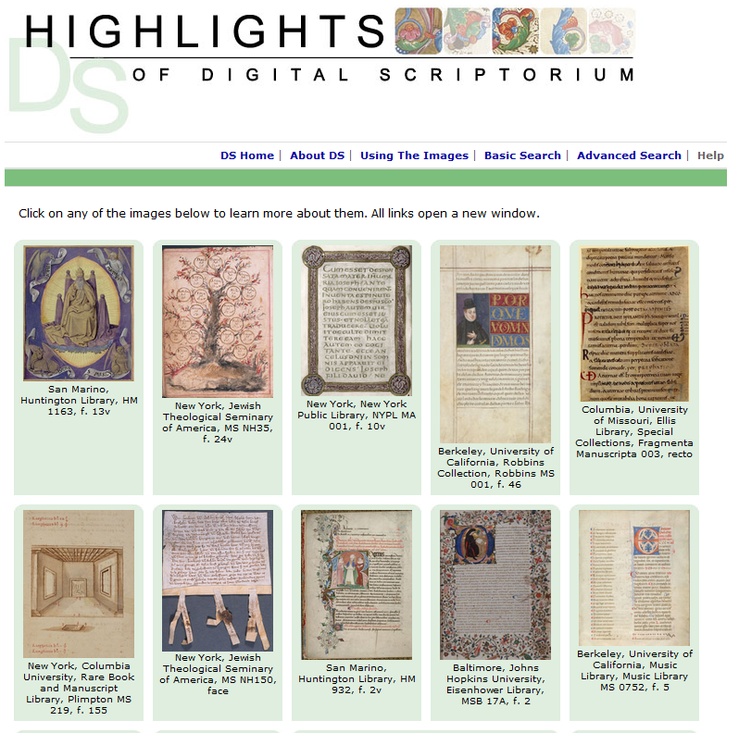

Slide 34
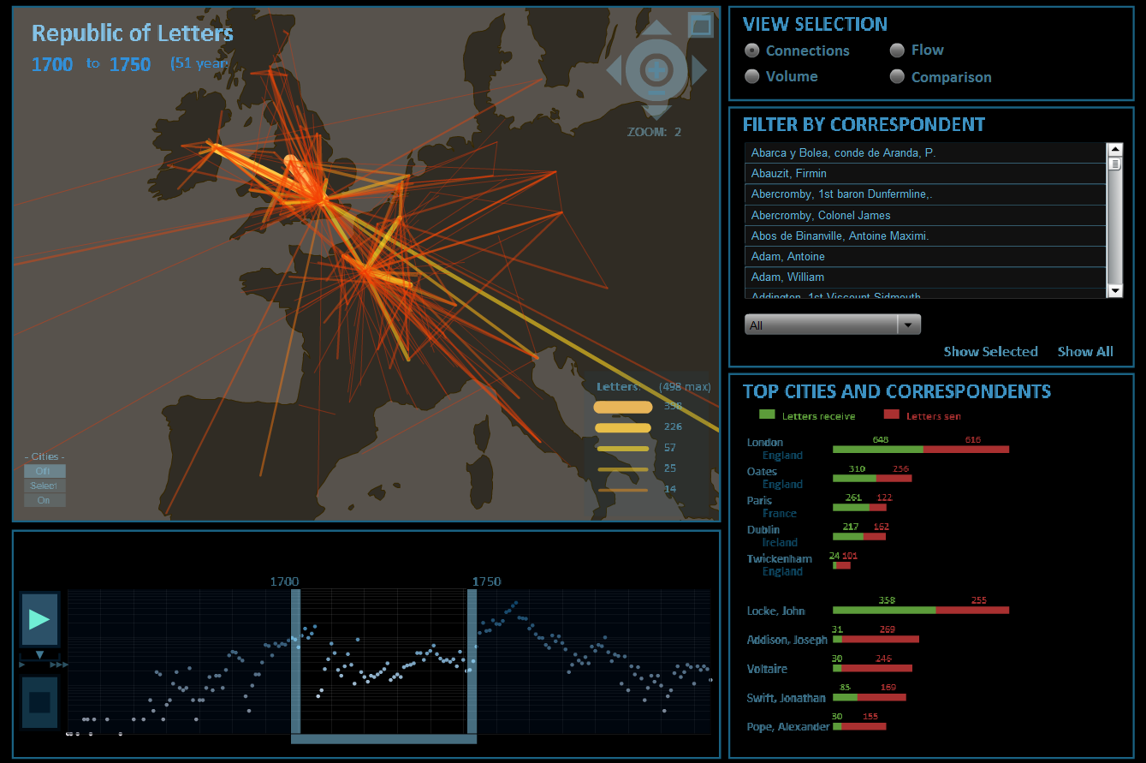

Slide 35
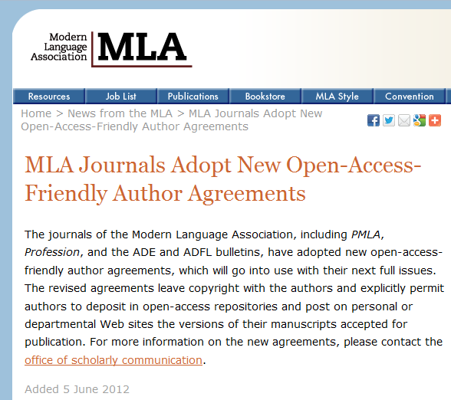
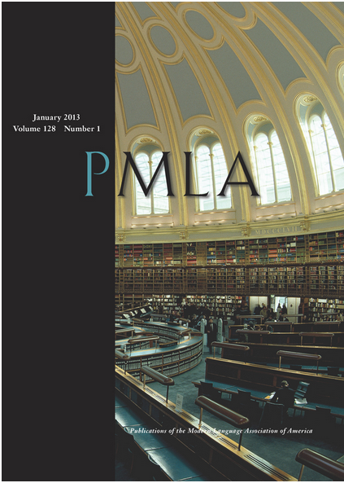
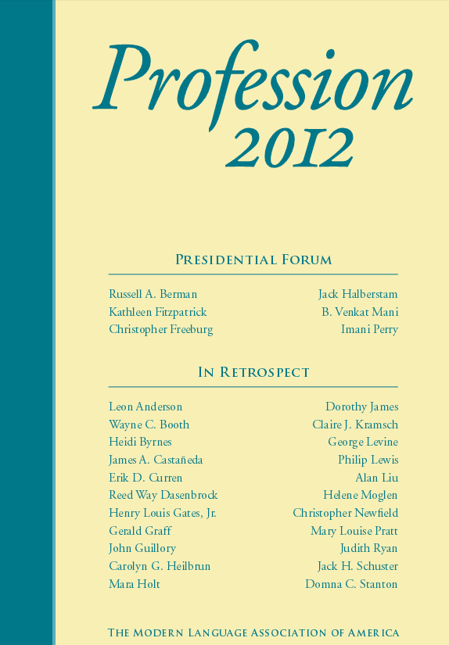

Slide 36
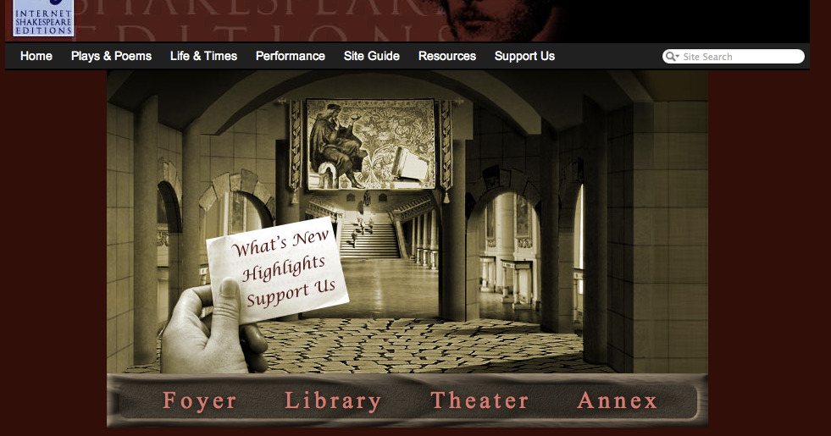
University of Victoria. Internet Shakespeare Editions (http://internetshakespeare.uvic.ca)

Slide 37
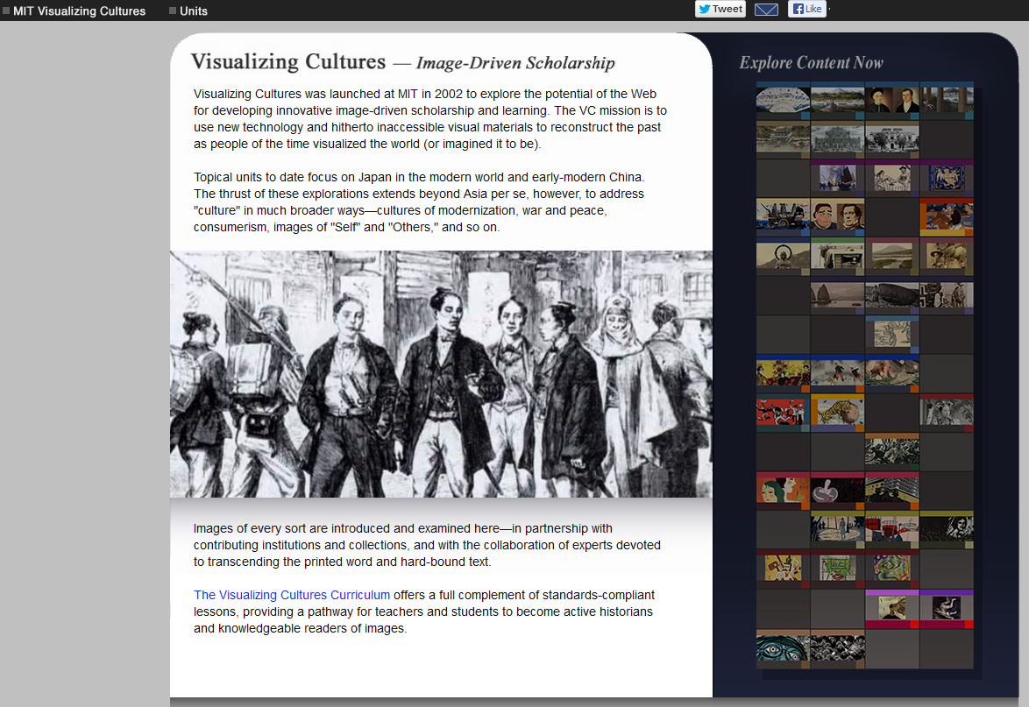

Slide 38
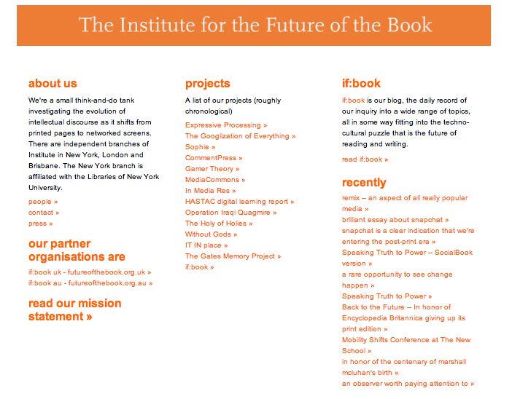

Slide 39
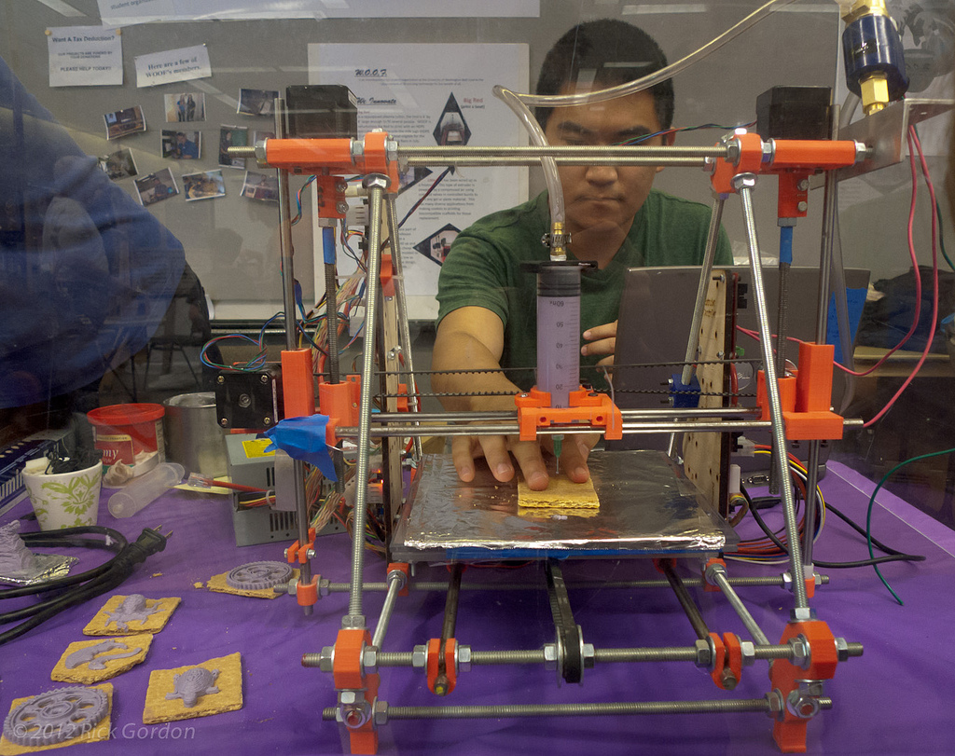
INTERDISCIPLINARITY
© Rick Gordon, used with permission under CC NC-ND

Slide 40
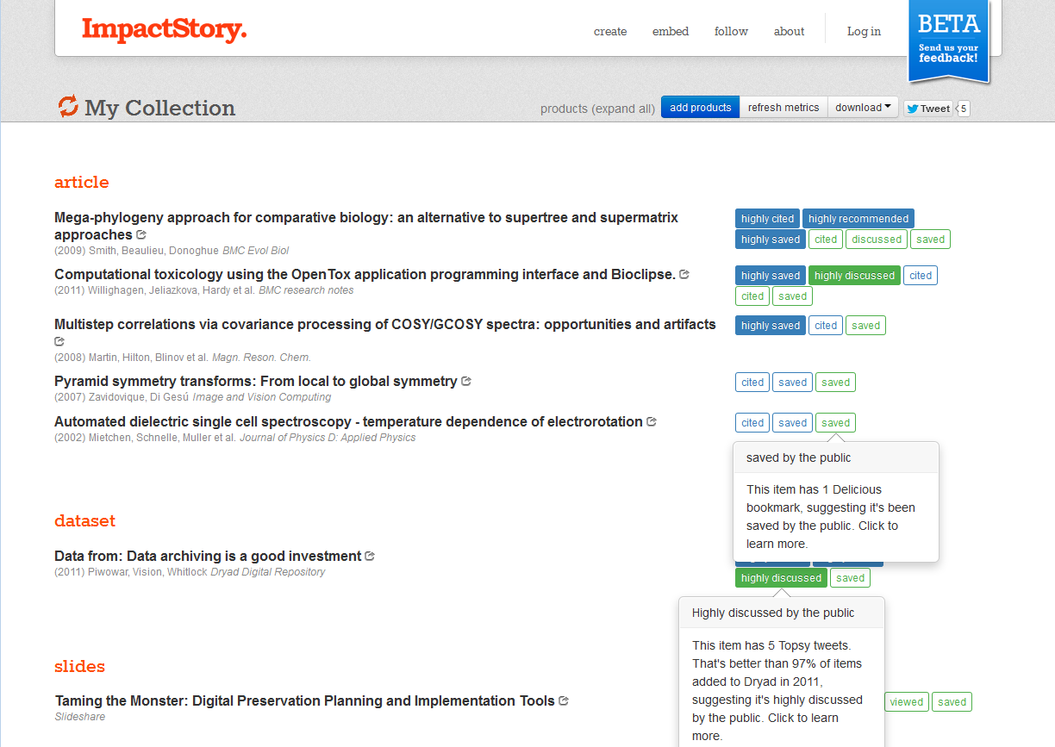
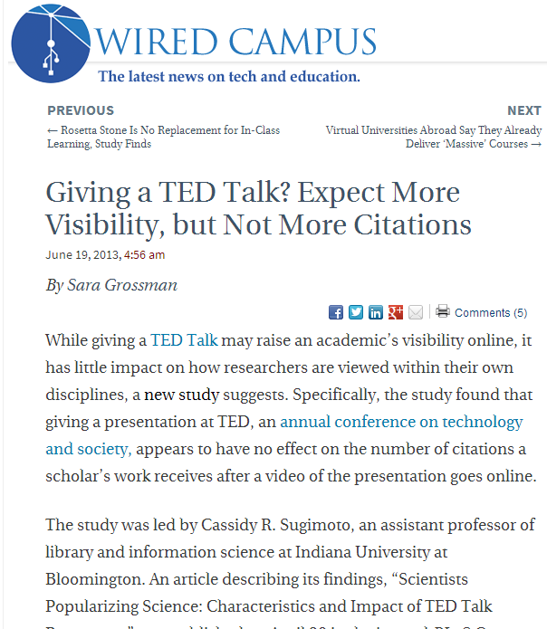
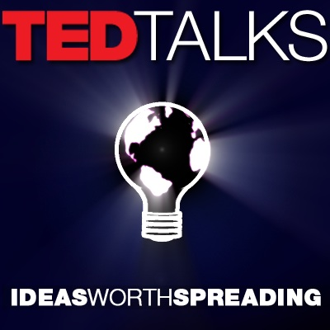
Measuring the impact of ‘Open’
Source: Screengrab from ImpactStory

Slide 41

Innovations in communication
Source: Screengrab from PeerJ and PaperCritic

Slide 42


Slide 43

Concluding remarks
Source: ©Andrew Blight, used with permission under CC-BY

Slide 44
Resources
Billings, M.S., Hutton, S.C., Schafer, J., Schweik, C.M. & Sheridan, M. Open Educational Resources as Learning Materials: Prospects and Strategies for University Libraries.(2013). Online: http://publications.arl.org/rli280/
Hey, T., Tansley, S., & Tolle, K. The Fourth Paradigm: Data Intensive Scientific Discovery. (2009). Redmond, WA: Microsoft Corporation. Online: http://research.microsoft.com/en-us/collaboration/fourthparadigm/
Housewright, R., Schonfeld, R.C. & Wulfson, K. Ithaka S+R US Faculty Survey 2012. (8 April 2013). Online: http://www.sr.ithaka.org/research-publications/us-faculty-survey-2012
Johnson, L., Adams Becker, S., Cummins, M., Estrada, V., Freeman, A., & Ludgate, H. (2013). NMC Horizon Report: 2013 Higher Education Edition. Austin, Texas: The New Media Consortium. Online: http://www.nmc.org/publications/2013-horizon-report-higher-ed
Mullins, J. L., Murray-Rust, C., Ogburn, J. L., Crow, R., Ivins, O., Mower, A., Nesdill, D., Newton, M. P., Speer, J., & Watkinson, C. (2012). Library Publishing Services: Strategies for Success: Final Research Report. Washington, DC: SPARC. Online: http://docs.lib.purdue.edu/purduepress_ebooks/24/
Smith, K.K. & N. L. Maron. Current Models of Digital Scholarly Communications: Results of an Investigation Conducted by Ithaka for the Association of Research Libraries. (2008). Online: http://www.arl.org/news/6/1148

Slide 45
Attribution
Portions of this work were originally created by Sarah L. Shreeves and revised by Marisa L. Ramírez and Joy Kirchner on June 3, 2013. This work is licensed under the Creative Commons Attribution-NonCommercial-ShareAlike 3.0 United States License. To view a copy of the license see http://creativecommons.org/licenses/by-nc-sa/3.0/us/

